Slide 1



Plant disease detection
using CNN
Presented by
B Group-7
Next Slide

Slide 2
LAKSHMI
SRINIVAS
CB.SC.U4AIE24116
CB.SC.U4AIE24140
TEAM
MEMBERS
MYAGI
SHANMATHI
CB.SC.U4AIE24143
CB.SC.U4AIE24152
Next Slide

Slide 3
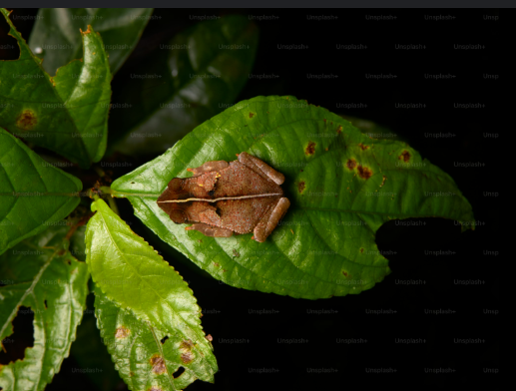
INTRODUCTION
Plant diseases significantly impact agricultural productivity. This project utilizes deep learning to detect and classify plant diseases from leaf images accurately.
Next Slide

Slide 4

OBJECTIVE
To develop a high-accuracy deep learning model using CNN for real-time detection of leaf images and integrate it into an interactive Stream lit web application for user-friendly accessibility
Next Slide

Slide 5
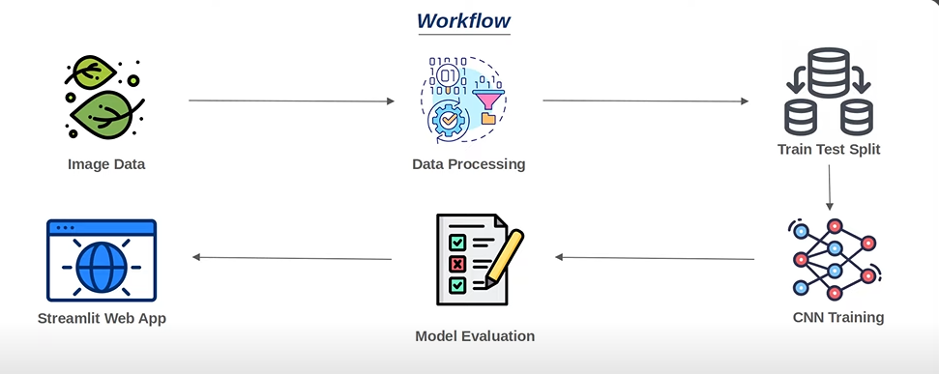
METHODOLOGY
Next Slide

Slide 6
The model is trained on the Plant Village dataset, containing healthy and diseased plant images. The dataset includes multiple plant species and various disease types.
The dataset is divided into training (80%) and validation (20%) sets to evaluate model performance.
A sequential CNN model is built using multiple convolutional layers for feature extraction.
Next Slide

Slide 7
A Conv2D layer with 32 filters and a 3×3 kernel size is applied, followed by ReLU activation.
A 2×2 MaxPooling layer is added to reduce the spatial dimensions and extract dominant features.
Another Conv2D layer with 64 filters enhances feature learning, followed by MaxPooling.
The 2D feature maps from CNN layers are flattened into a 1D vector for input to the dense layers.
Next Slide

Slide 8
A dense layer with neurons and ReLU activation is used to learn complex patterns.
A final dense layer with softmax activation is used to classify the images into multiple disease categories.
The model’s performance is validated using the validation dataset to monitor overfitting.
Next Slide

Slide 9
Accuracy and loss are tracked during training to assess model improvements.
The trained model is tested on unseen plant images to evaluate real-world performance.
The results are analyzed using accuracy and loss plots for both training and testing data to evaluate the model's performance.
Next Slide

Slide 10
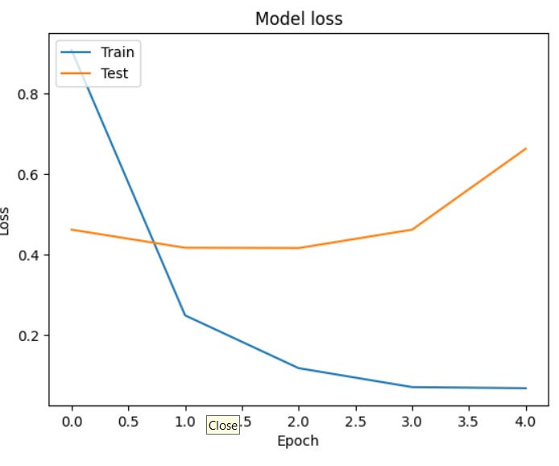
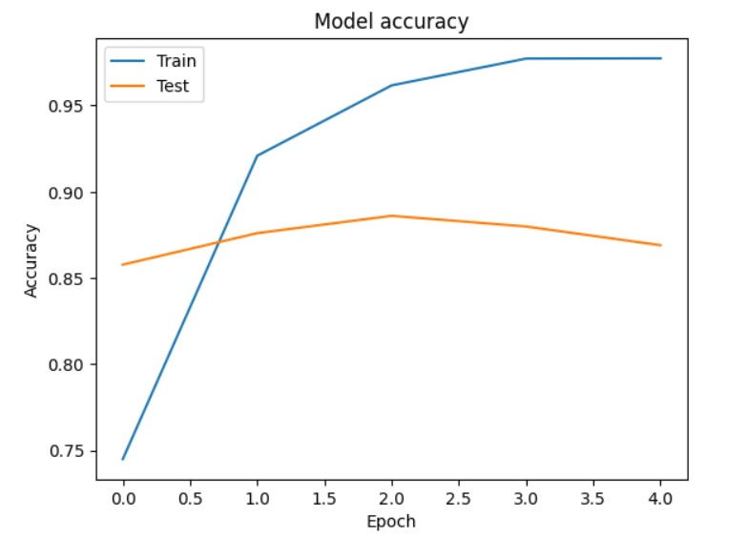
RESULT
We have achieved a validation accuracy of 86.90% in predicting plant diseases using a CNN model. Below are the accuracies and loss values for training and testing data:
We shall develop a Streamlit web app that allows users to upload an image of a plant and identify plant diseases.
Next Slide

Slide 11
TIME LINE
WEEK 1
WEEK 3
Collecting the research papers and understanding CNN.
Working on the codes
WEEK 4
WEEK 2
Searching Dataset and preprocessing it.
Develop a Stream lit Web
Next Slide

Slide 12
Thank
You!

